Slide 1

Change Air Intake Filter 1990 - 1997
Resources
Air filter replacement for 1990-1997 Miata. - Bing video

Slide 2
Tools List:
Part List:
10 mm wrench/Socket with ratchet
OR
#3 Phillips head screwdriver
(OPTIONAL) Shop Vacuum
Filter
*The bolts on the air filter compartment allow you to use either tool
*Sometimes excess debris can build up in the intake compartment box, it is always a good idea to clean it out while you have it open.

Slide 3
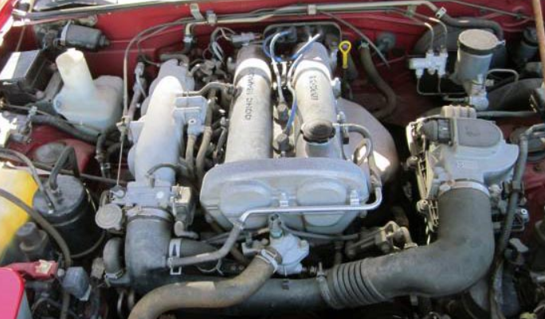
Step 1:
First you need obtain the correct filter.
In here is where the filter is located

Slide 4
Step 2:
Open the hood.
Pull the hood Release lever in the driver side foot space.
Reach between the hood and the car to unlatch the hood’s safety by pushing it to the left.
Prop the hood up using the hood prop and place it in the hole that has an arrow and has a label says “Rod”

Slide 5
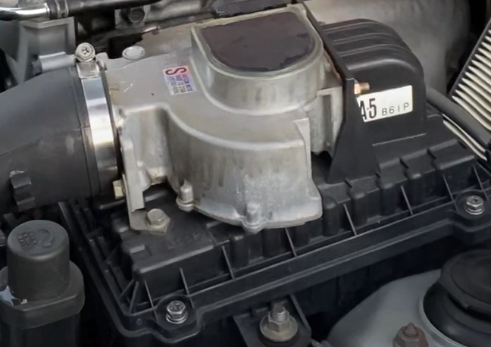
Step 3:
OR use the 10 mm wrench
OR use a 10 mm socket with ratchet
Gain access to the air intake filter.
Use your #3 Phillips head screwdriver to remove the four bolts on the air intake housing
3
2
4
1

Slide 6
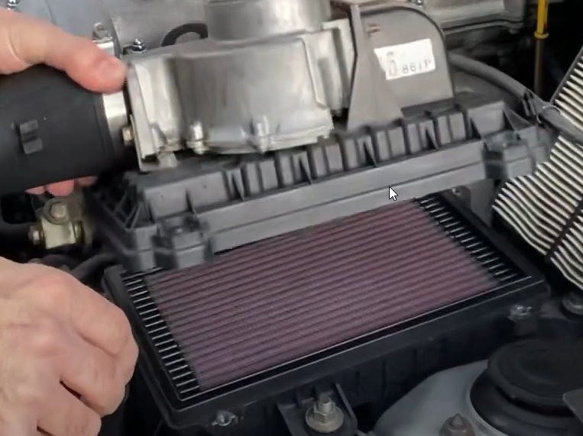
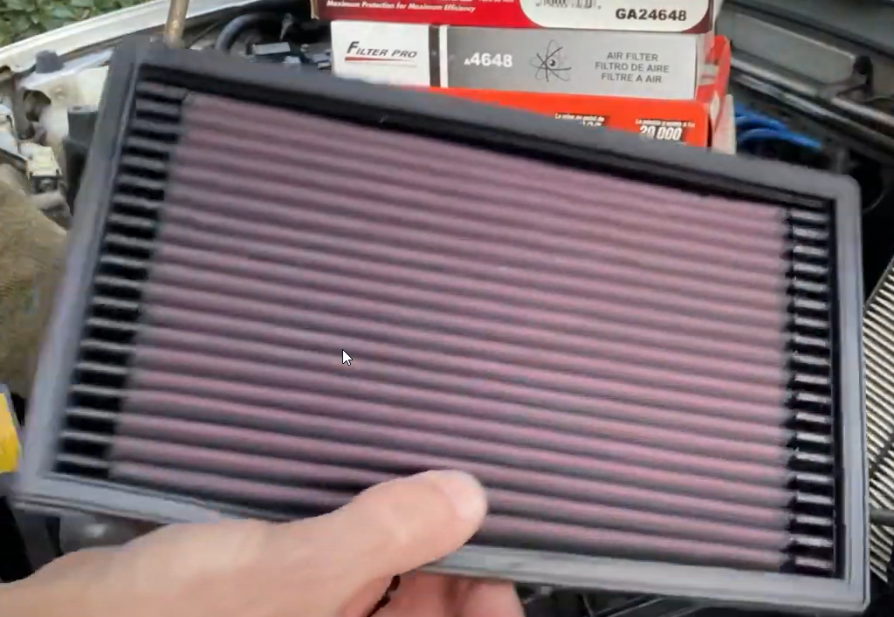
Step 4:
Gently lift the air intake manifold and remove the Filter.

Slide 7
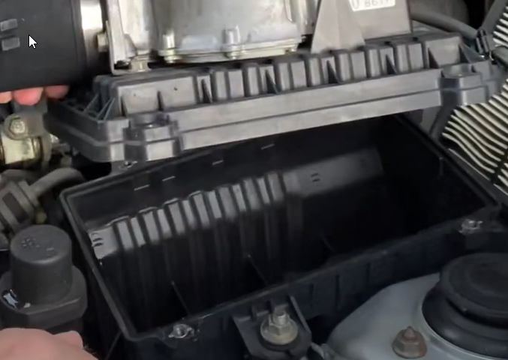
Step 5:
Inspect and clean the inside of the intake air filter compartment.
* Excess debris can build up here. You can either wipe it out OR run a vacuum hose in there to ensure you get any junk out of this compartment
IN HERE

Slide 8
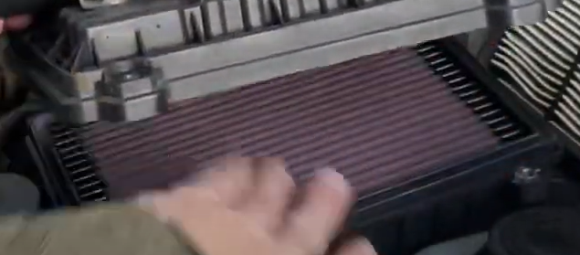
Step 6:
Compare your new filter with the old to ensure that you have the correct size.
Slide the new air filter in the compartment
*Ensure that when you put it in that it is flush other wise it will not work properly

Slide 9
Step 7:
OR use the 10 mm wrench
OR use a 10 mm socket with ratchet
Reattach the air intake manifold.
Place the aligned manifold in place
Put back the 4 bolts back that you took out in step 3.
Use your #3 Screwdriver to snug up the bolts.
*DO NOT over tighten or you will strip the threads and need to replace the intake.
3
2
4
1

Slide 10
Step 8:
Close the hood.
* Ensure that the hood latch is fully latched by trying to lift up on the hood. IF you CAN still wiggle it or put your hand under it, IT IS NOT fully latched, and this is dangerous.
All Done!

